Slide 1
Internet Research
Wrap-up and Review

Slide 2
List 4 Examples of Internet Browsers
Edge
Chrome
Firefox
Safari

Slide 3
What is the most widely used browser?
Google Chrome

Slide 4
List Examples of Search engines
Google
Bing
Yahoo
Ask
Dog pile

Slide 5
What is the most widely used search engine?
Google

Slide 6
Give reasons Why copying and pasting, Plagiarism is a bad idea…
Learn very little, if anything
Being dishonest
Teacher will know
Failing grade
Embarrassment
Defeats purpose of the assignment

Slide 7
What are generally the most reliable sites?
edu
.gov
Sometimes .org

Slide 8
.com
commercial

Slide 9
.edu
education

Slide 10
.org
organization

Slide 11
.gov
government

Slide 12
.net
Internet
network

Slide 13
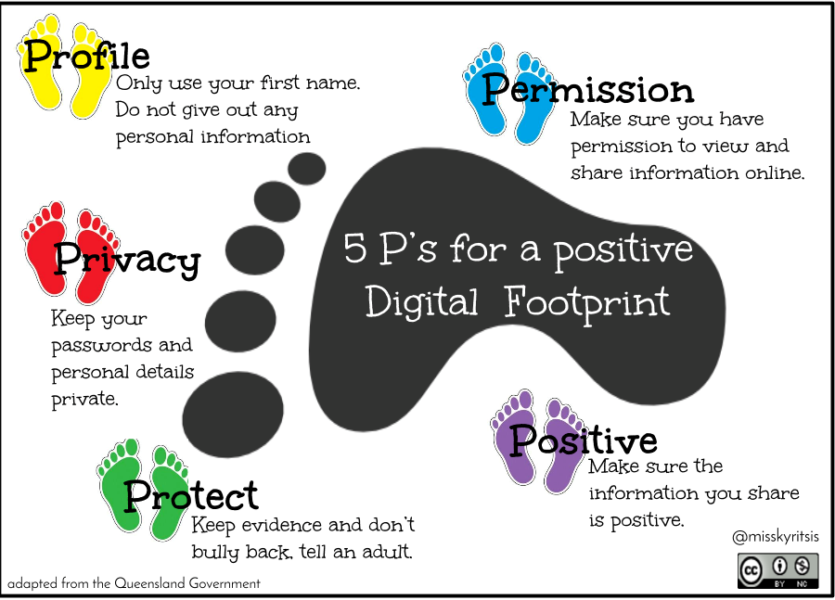
What are the 5 p’s of a positive footprint
Profile
Permission
Positive
Protect
Privacy

Slide 14
What does think stand for
T - True
H - Helpful
I - Inspiring
N - Necessary
K - Kind

